Slide 1


Social Buzz
Content Performance Report

Slide 2


Today's agenda
Project recap
Problem
The Analytics team
Process
Insights
Summary

Slide 3

Social Buzz is the fastest growing technology unicorn that needs to adapt quickly to its global scale.
Accenture has begun three month POC focusing on these task.
An audit of their big data practice.
Recommendations for a successful IPO.
An analysis to find Social Buzz’s top 5 most popular categories of content.
Project Recap

Slide 4


Problem
Over 100,000 posts per day.
3,65,00,000 pieces of content every year.
But when to capitalize on it when there is so much
Analysis to find Social Buzz top 5 most categories of content.

Slide 5



Marcus Rampton
Senior Principal
The Analytics team
Andrew Fleming
Chief Technical Architect
(Myself)
Data Analyst

Slide 6
Process
1
Data Understanding
2
Data Cleaning
3
Data Modelling
4
Data Analysis
5
Uncover Insights

Slide 7

Insights
From previous slide we get insights from data.
January
Month with
Most post
16
Unique
Categories
1897
Reaction to
Animal posts

Slide 8
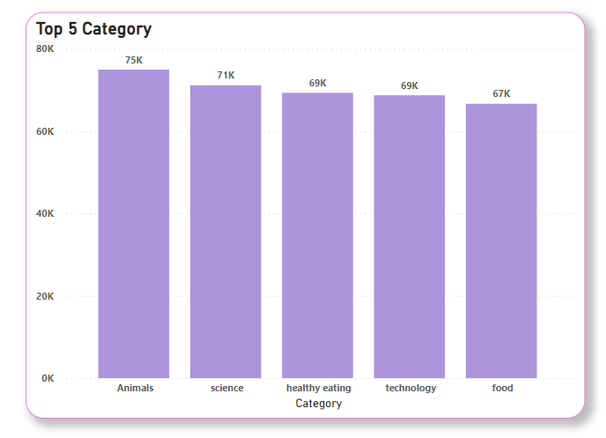
Sum of each category. The marks are labeled by sum of score.

Slide 9
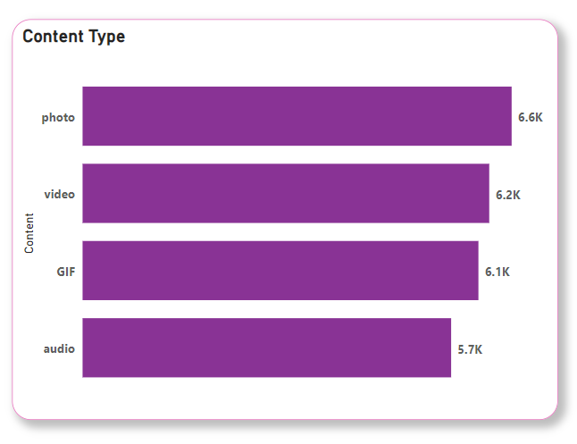
Photos are most posted in Social Buzz.

Slide 10

Analysis
Animals and science are the two most popular categories of content showing that people enjoy real life and factual content the most.
Photos are most posted in Social Buzz.
Insights
Food is common theme with the top 5 popular categories with healthy eating is the highest.
This may give an indication to audience within user base.
You could use this insight to create a campaign work with healthy eating brands to boost user engagement.
Summary
Next Steps
This ad-hoc analysis is insightful, but its time to take this analysis into large scale production for real time understanding of your business. We can show you how to do.

Slide 11

Thank you!
ANY QUESTIONS?

